Slide 1
What is Best Country to Invest in?
By MALNICH

Slide 2
Introduction
This case study looks which country would be the best for a business looking to expand
Data: 2021
Countries: EU+G20

Slide 3
Source:
https://data.worldbank.org/country
https://en.wikipedia.org/wiki/List_of_countries_by_tertiary_education_attainment
https://research.stlouisfed.org/
Education and training monitor EU Commision
https://worldpopulationreview.com/country-rankings/literacy-rate-by-country
https://www.transparency.org/en/cpi/2019

Slide 4
How Score is Calculated
Combination of multiple metrics added together to get a total score
Unemployment Rate, GDP Growth, Index of Economic Freedom, Index of Capital per Person, Corruption Perceptions Index, Literacy Rate, Tertiary Education Attiainmment

Slide 6
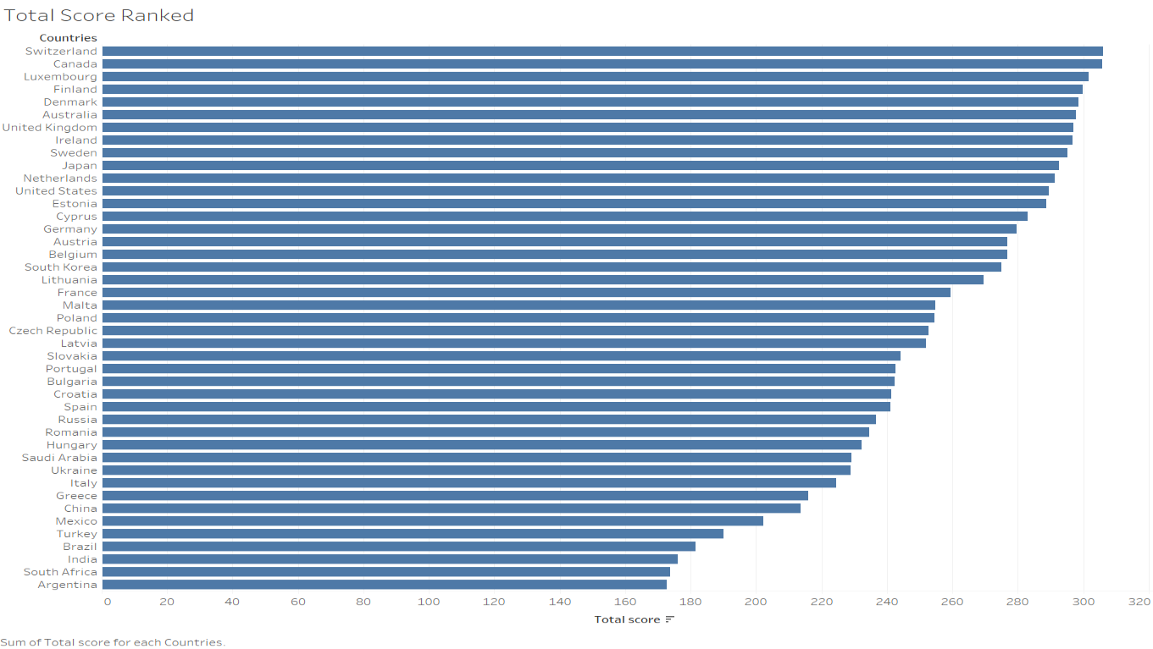

Slide 7
Unemployment Rate

Slide 8
GDP Growth

Slide 9
Inflation rate

Slide 10
Index of Economic Freedom

Slide 11
Corruptions Perceptions Index

Slide 12
Literacy Rate

Slide 13
Tertiary Education Attainment

Slide 14
Recommendations
Switzerland=Best Overall Score
Ireland= High in Multiple Metrics
Denmark = Least corrupt country
China= High GDP Growth

Slide 15
Conclusion
Multiple countries to choose from depending on what business environment you are looking for
Countries with low corruption, high economic growth, highly education population or low inflation rate, high economic freedom

